Slide 1

Great Britian bike accidents
Bar Partush
Ron Yehuda

Slide 2
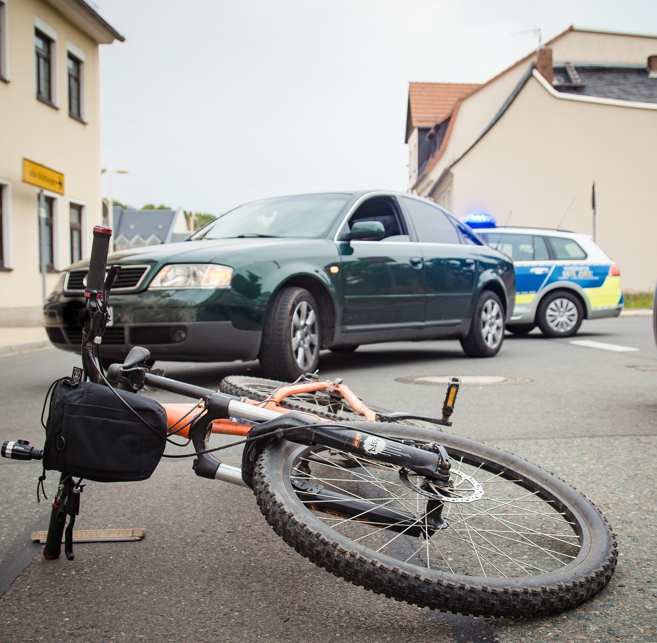
Our data base contains data about most of the reported bike accidents occurred at Great Britian between 1979 – 2018.
The database contains information on the severity of the injury, the speed allowed on the road, age group, weather, gender, etc.
Today, we will try to look on this data from different angles and find some interesting conclusions.

Slide 3
Research goals
What is the main factors that affects the severity of the injury ?
Speed limit
Number of cars involved
Day of the week
Does the gender of the rider affect the characteristics of the accident?
Yes
Severity
Age group
Speed limit

Slide 4
Research methods
Pandas \ Numpy – we used pandas and numpy to store, modify and filter the datasets.
Mathplotlib \ seaborn – used to build graphs and plots to present the data usefully and clearly.
SciPy(Stats) - statistical functions and distributions to analyze the datasets.

Slide 5
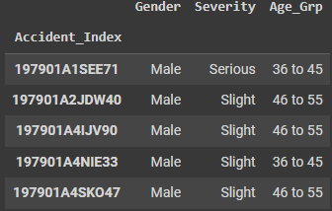
Datasets review
In our analysis, we used two connected datasets. Each of them contains data about 827,871 accidents. Let’s present them one by one:
The first dataset contains data about the biker – gender, severity of the biker’s injury and the biker’s age group.

Slide 6
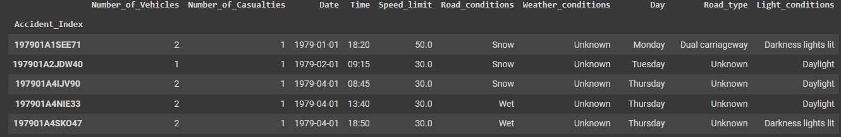
Datasets review
The second dataset give us a data on the accident that’s not related to the biker, such as road condition, weather, road speed limit, etc.
As you can see, both datasets sharing the same indexing method, and pointing to the same accidents, so we can use both to look at the same accident and examen it more efficiently.

Slide 7
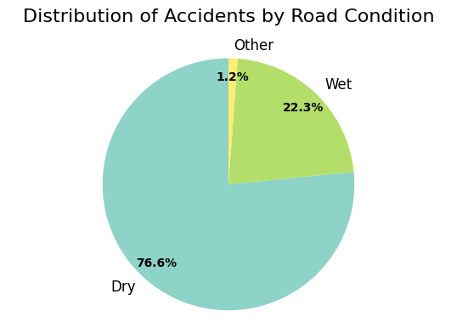
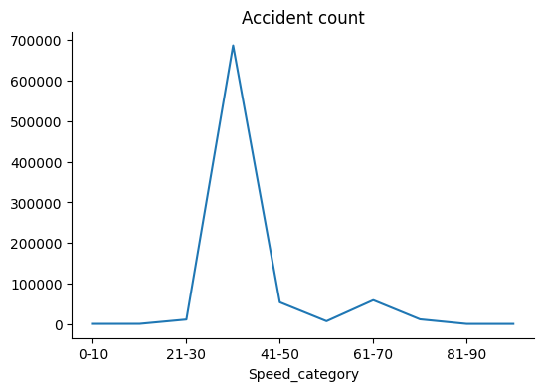
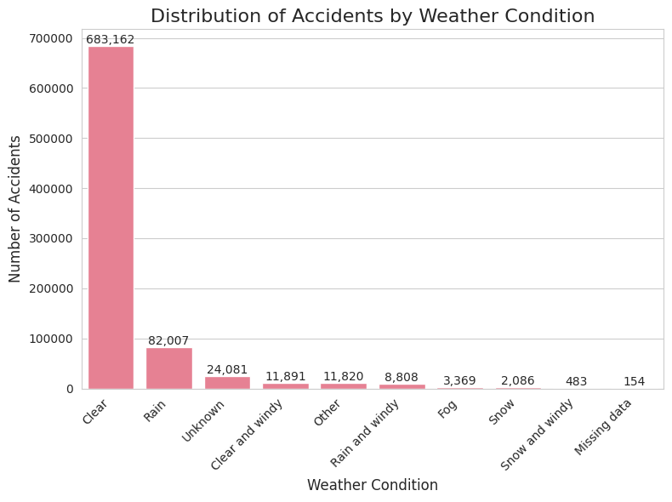
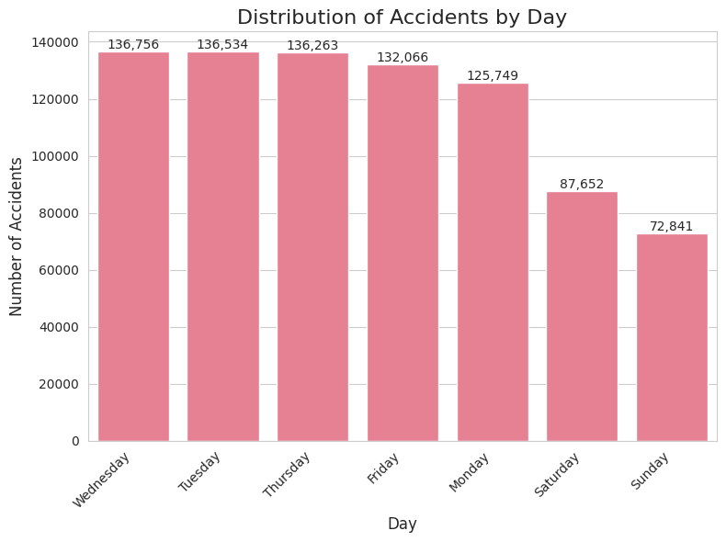
Basic data analysis
Let’s take a look at some basic analysis to understand the numbers better.

Slide 8
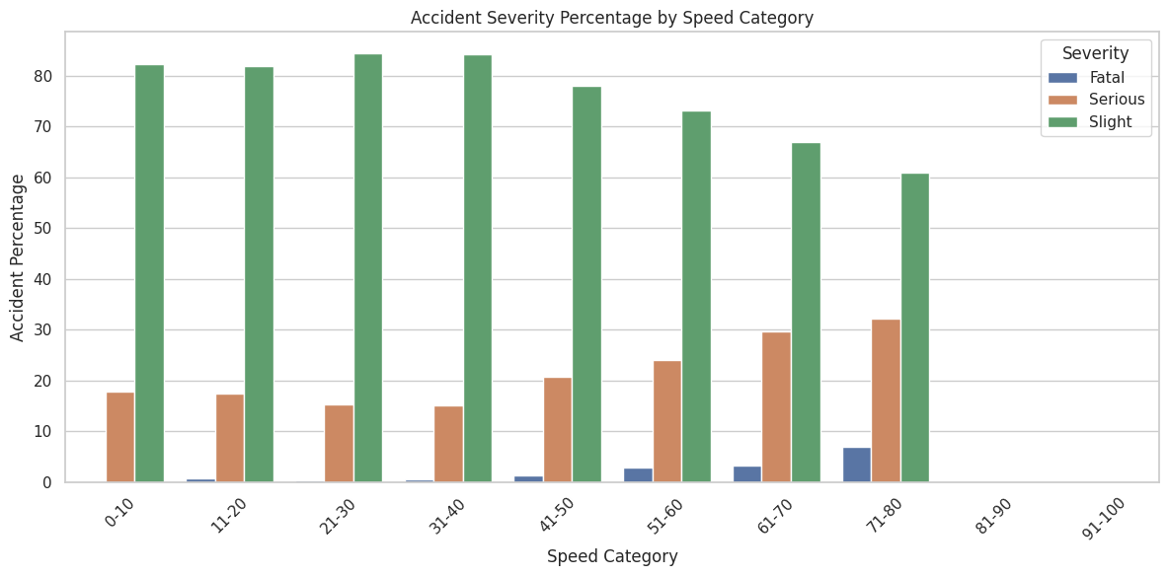
Combined data
Let’s divide the accident into speed categories and look at the percentage of injury severity per each category.
As expected, the severity of the biker injury is deeply connected to the road speed-limit.
HIGH SPEED
=
HIGHER CHANCE FOR SERIOUS INJURY

Slide 9
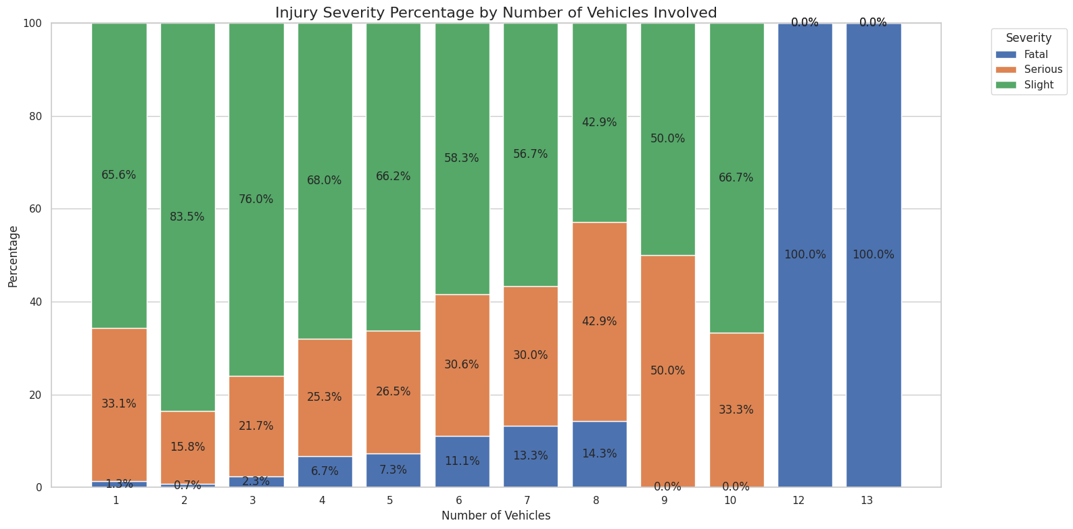
Combined data
Let’s divide the accident by number of vehicles involved and look at the percentage of injury severity per each category.
We can learn from the graph that the severity of the injury is affected by the number of vehicles involved. When the number of vehicles increase, the severity increases as well.

Slide 10
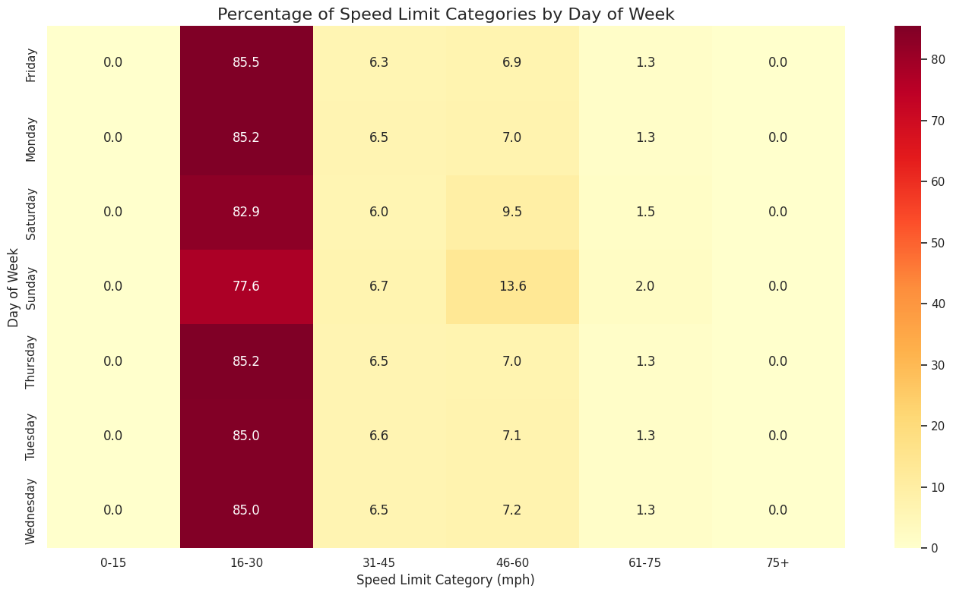
Combined data
Now let’s look if there any connection between the day the accident occurs and the road speed-limit.
We can see that in the weekends – there is a big increase in accident occurs at high speed-limit roads.

Slide 11
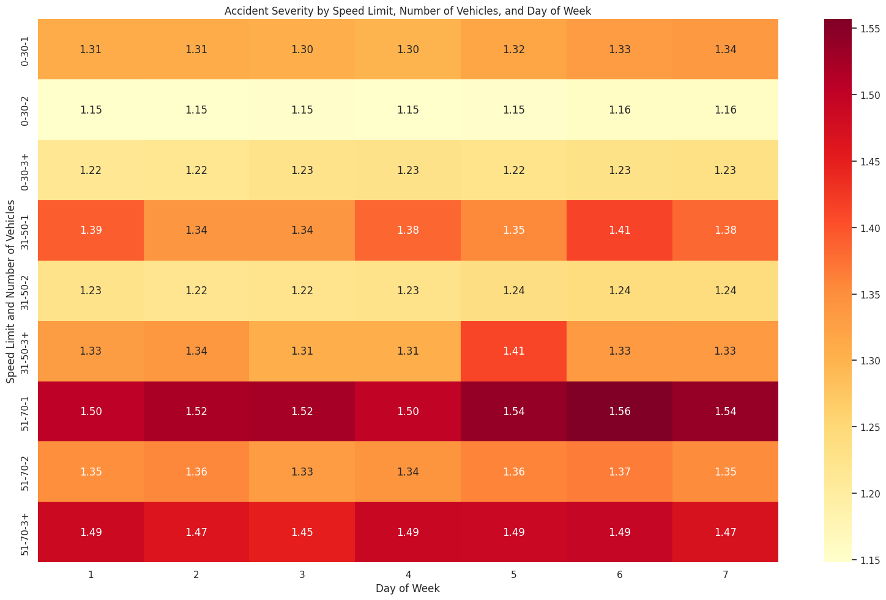
Combined data
This heat map combines the 2 graphs we saw before.
In this heat map we transferred the injury severity into numbers :
1 – Slight
2 – Serious
3 – Fatal
The heat map shows the average value of the severity per each group.
From these graph we can conclude the same as the last 2 graphs together.
We can see that accidents with 2 vehicles are the slightest, we can see that higher speed limit causes higher chance for serious injuries.
In addition, we added the day factor - and we can see it have almost no influence ( in terms of injury severity ).

Slide 12
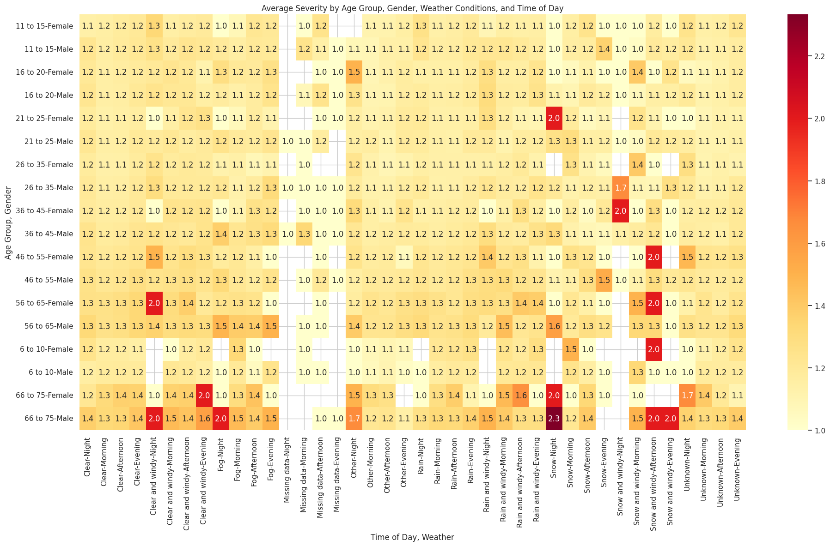

Slide 13
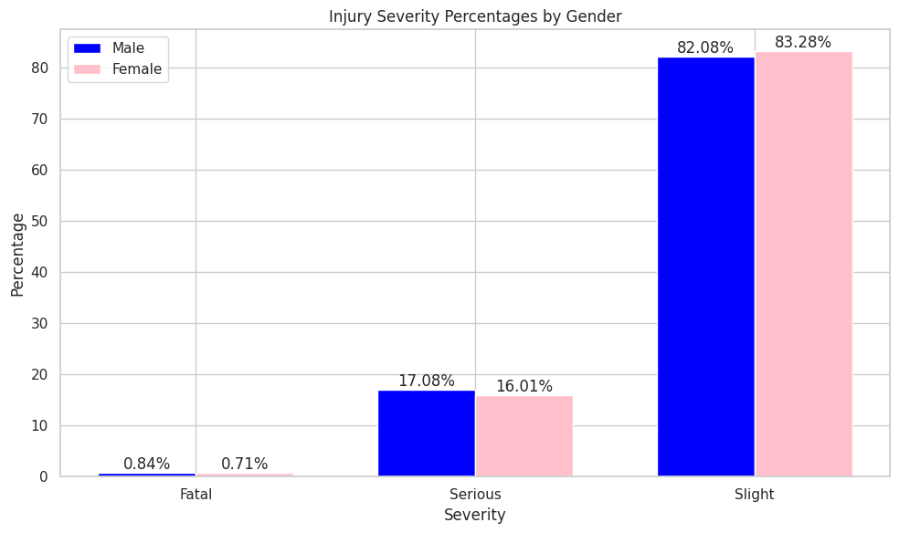
Gender based comparison
In the next few minutes, we will look at filtered data to check if there is a connection between the gender of the rider and certain characteristics of the accident, and perhaps even determine if there is a certain gender that "rides better"
In this bar graph, you can see the injury severity percentages by gender. As we can see, the percentages is almost equal, and the difference is negligible.

Slide 14
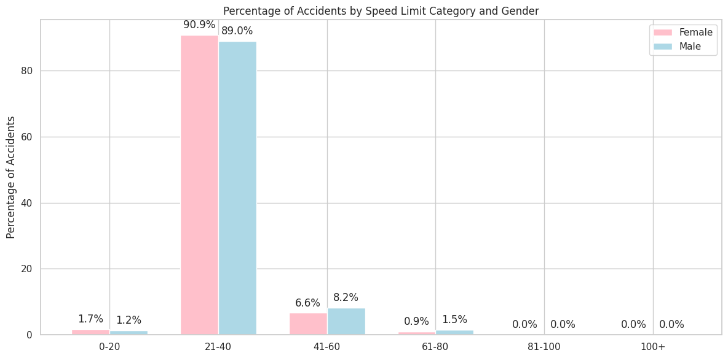
Gender based comparison
Now we will look at the difference between the speed limit on the road where the accident happened, for each gender separately.
Women's accidents occur more frequently at low speeds, while men's accidents occur more often at high speeds. Although the difference does not appear to be very significant, men's percentage for very high-speed accidents (61-80) is almost double that of women's. In the '0-20' speed category, women have almost 50% more accidents than men.

Slide 15
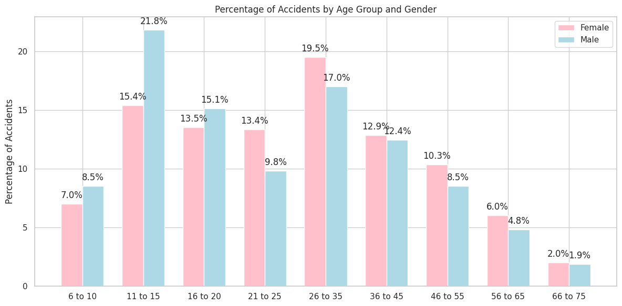
Gender based comparison
Let’s look for a connection between the gender and the age group of the biker.
It is easy to see that men tend to be involved in more accidents when they are young, but once they pass their 20s, they are involved in fewer accidents than women relatively.

Slide 16
Conclusions
What main factors affects the injury severity?
In our research, we looked on 3 different factors – speed limit, day of the week and number of involved vehicles. As excepted – we saw that higher speed causes increasing the injury severity. We also saw that, surprisingly, that accidents with 2 vehicles tend to be less sever, and as the number of vehicles increasing(3+), the severity increase as well. The day has almost no affect on the severity, but we did saw that on weekends, accidents tend to be in higher speed-limit roads.
How the biker gender affects the accident factors?
We saw that females tend to cause more accidents in low speeds (0 – 40 ), while males causes more accidents in high speeds (40 – 60). We saw that males make their most accidents while they are young (0 – 20), while females prime age is 21-35.
Aldo there is noticeable difference in those 2 factors - we saw that the injury severity is almost the same for both genders.
So, females are better drivers in low speeds, when they are young – and males are better drivers in high speeds, when they are adults.

